Slide 1
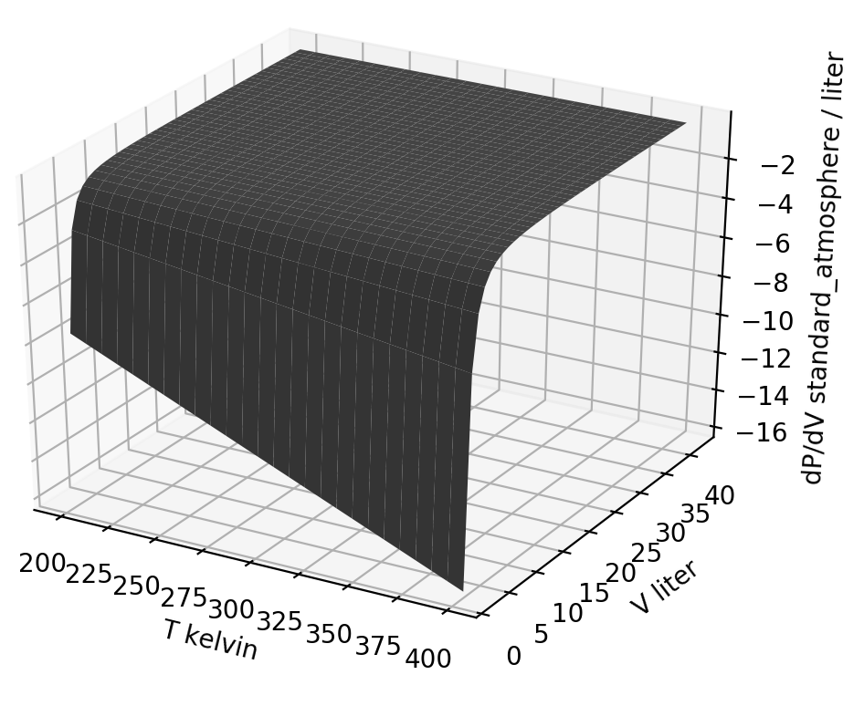
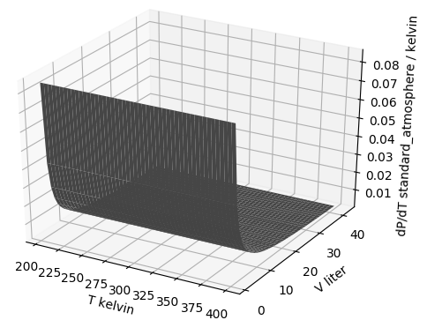
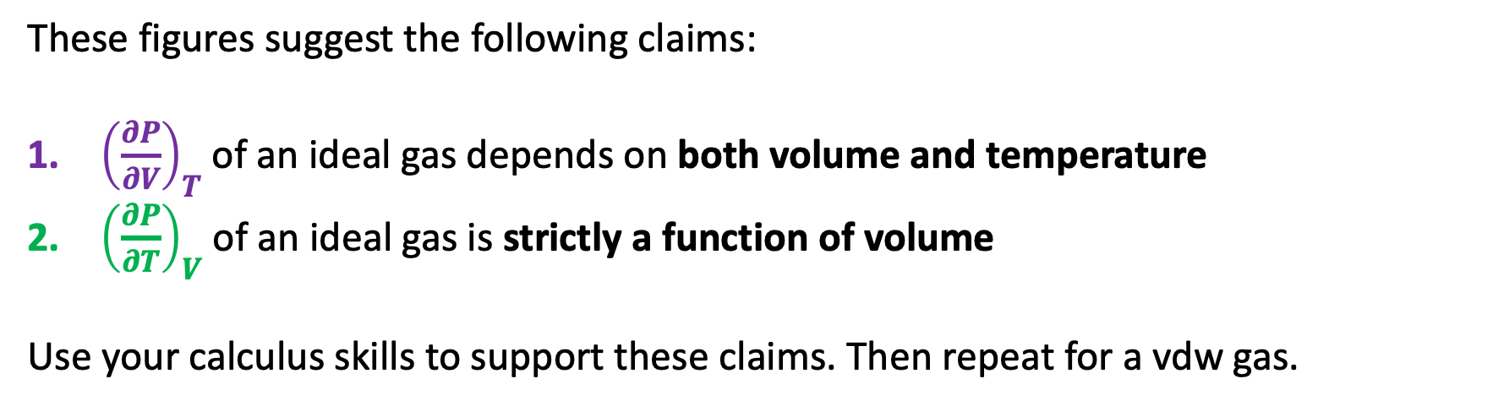
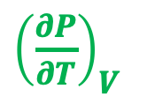
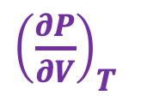
Blackboard challenge #1: How ${\left(\frac{∂P}{∂V}\right)}_{T}$ and ${\left(\frac{∂P}{∂T}\right)}_{V}$ depend on temperature and volume
Here are slopes of the pressure of an ideal gas, depicted as thermodynamic surfaces:
${\left(\frac{∂P}{∂V}\right)}_{T}$
${\left(\frac{∂P}{∂T}\right)}_{V}$
These figures suggest the following claims:
${\left(\frac{∂P}{∂V}\right)}_{T}$ of an ideal gas depends on both volume and temperature
${\left(\frac{∂P}{∂T}\right)}_{V}$ of an ideal gas is strictly a function of volume
Use your calculus skills to support these claims. Then repeat for a vdw gas.

Slide 2
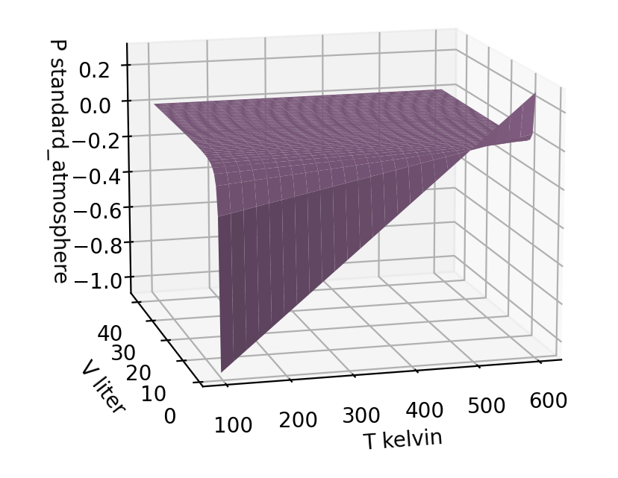
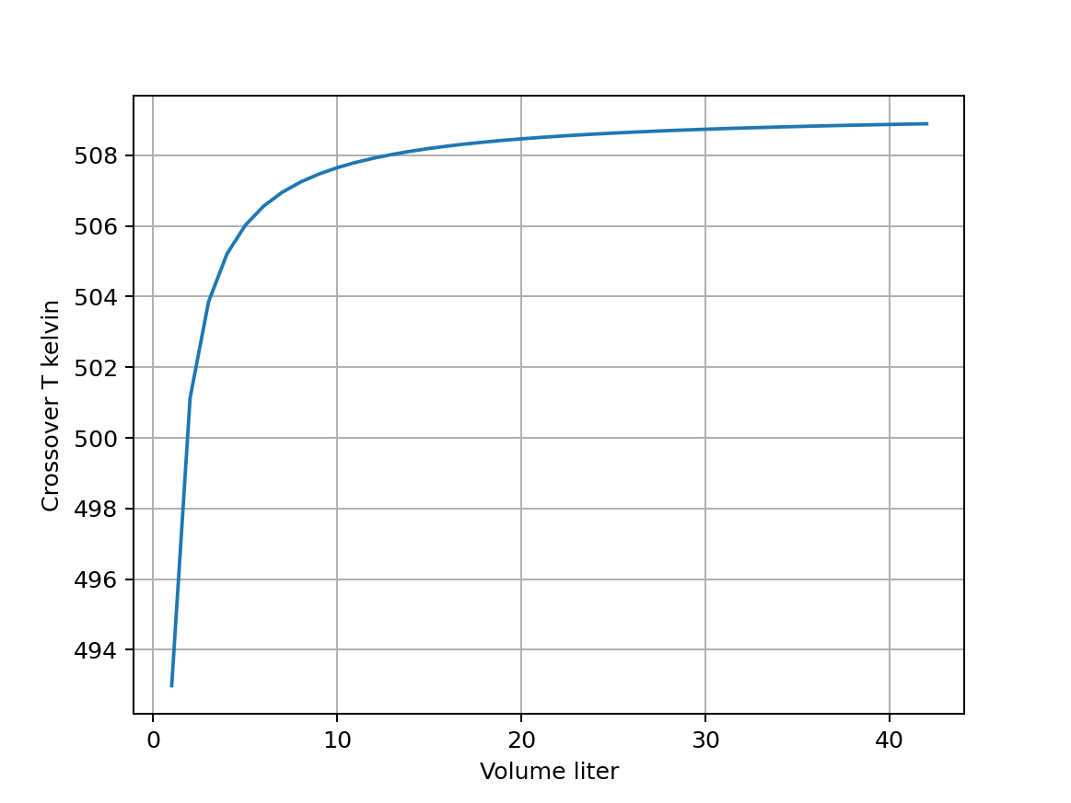
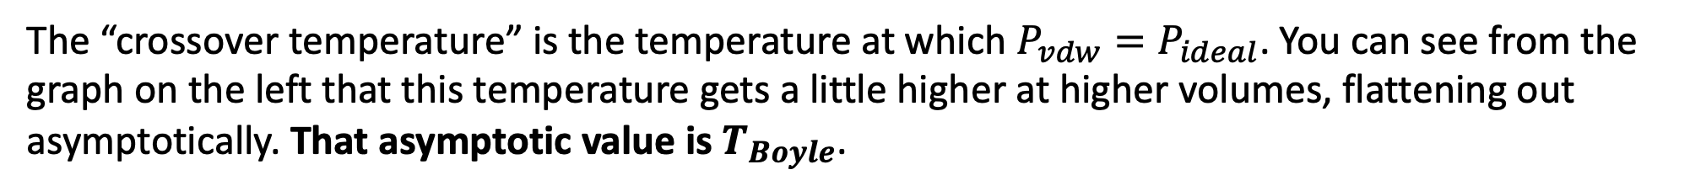

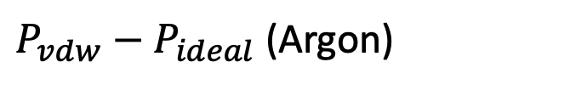
Blackboard challenge #2: Analytical derivation of the Boyle temperature of a vdw gas
The “crossover temperature” is the temperature at which $P_{vdw}=P_{ideal}$. You can see from the graph on the left that this temperature gets a little higher at higher volumes, flattening out asymptotically. That asymptotic value is $T_{Boyle}$.
$P_{vdw}−P_{ideal}$ (Argon)
$$T_{Boyle}$$
Derive $T_{Boyle}$, the asymptotic (large V) limit of the crossover temperature

Slide 3
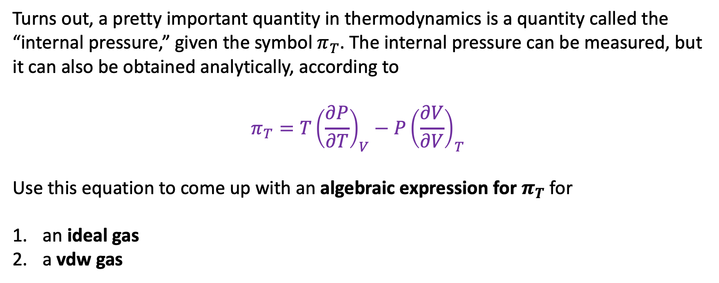
Blackboard challenge #3: Derivation of $π_{T}$
Turns out, a pretty important quantity in thermodynamics is a quantity called the “internal pressure,” given the symbol $π_{T}$. The internal pressure can be measured, but it can also be obtained analytically, according to
$$π_{T}=T{\left(\frac{∂P}{∂T}\right)}_{V}−P{\left(\frac{∂V}{∂V}\right)}_{T}$$
Use this equation to come up with an algebraic expression for $π_{T}$ for
an ideal gas
a vdw gas

